Slide 1

Azure funtions
Add Subtitle

Slide 2
Azure Functions
Introduction
Triggers
Hosting Plan
Comparison

Slide 3
Introduction
Azure Functions is a cloud service available on-demand that provides infrastructure and resources needed to run your applications.
Azure Functions is a serverless solution that allows you to write less code, maintain less infrastructure, and save on costs.
You can use Functions to build web APIs, respond to database changes, process IoT streams, manage message queues, and more.
In my words:
We always want some code/function to run when any even occur. Using Azure functions, we can write blocks of code which are called functions and we can run these functions/code anytime we want on the event trigger. If our request increases, Azure function handles by providing resources to meet the demand and function instances but only when needed. As request falls, extra resources and instances drop off automatically.

Slide 4
Event triggers
Azure function can also be invoked via HTTP trigger.
If you want to run Azure function when something is uploaded to the Azure Blob Storage.
Run custom logic/Azure function logic when document is created or updated in the Azure Cosmos DB/ Azure Cosmos DB Trigger.
Timer Triggers: Where you can define/schedule when your function should run.
Process message queues using Queue Storage, Service Bus, or Event Hubs.
- Above are some examples where some event happened, and Azure functions gets triggered. More time of triggers/cloud services are available which can use to trigger our custom code/function.
- We can also write Azure functions in different languages and do the azure deployment using the external ADO pipelines. We can also avail pricing according to our need.

Slide 5
Durable Function : term to remember
Durable Functions is an extension of Azure Functions that lets you write stateful functions in a serverless compute environment.
Orchestration: term to remember
An orchestration is a collection of functions, or actions in Azure Logic Apps, that you can run to complete a complex task

Slide 6
Comparison between Power Automate Flow and Logic Apps
Both are workflows only. Power Automate flow is built on top of the Logic Apps.
Power automate flows do simple integration and Logic app can also do Advance Integration.
Non-technical users can use Power automate flows easily and developers can use Logic Apps.
Comparison between Azure Functions and Logic Apps
Azure function we write the code to perform number of actions.
Azure logic app we write the workflow to execute the number of actions.
Both provide serverless workloads.

Slide 7
Web Jobs AND web JOBS SDK
Web Jobs and Web Jobs SDK are also code which we write in Azure functions.
But as compared to these 2, azure support more programming language and pricing options are better.
We can go for Azure function but in case we have to do some customization in host.json file or we want custom retry policy for Azure storage then we can go for Web jobs.
Web jobs can be run under Azure service app plan, but web jobs SDK is a consoled application which can run anywhere like even in the on-premise servers.
We can use anything like power automate flows, azure logic apps, azure functions, web jobs anything as per our need . We can connect each other easily; we can call flows from logic apps or azure function from power automate flow. So, anything is possible.
They all integrate with each other as well as with the external services.

Slide 8
Hosting Plan
We need a function app in which we can create an Azure function. There are different type of hosting plans available for the function app.
When you create a function app in Azure, you must choose a hosting plan for your app. There are three basic hosting plans available for Azure Functions: Consumption plan, Premium plan, and Dedicated (App Service) plan. According to the plan we choose there are different timeout duration for azure functions.
Plan | Benefits
Consumption plan | Scale automatically and only pay for compute resources when your functions are running. On the Consumption plan, instances of the Functions host are dynamically added and removed based on the number of incoming events. ✔ Default hosting plan. ✔ Pay only when your functions are running. ✔ Scales automatically, even during periods of high load.

Slide 9
Premium plan | Automatically scales based on demand using pre-warmed workers, which run applications with no delay after being idle, runs on more powerful instances, and connects to virtual networks. Consider the Azure Functions Premium plan in the following situations: ✔ Your function apps run continuously, or nearly continuously. ✔ You have a high number of small executions and a high execution bill, but low GB seconds in the Consumption plan. ✔ You need more CPU or memory options than what is provided by the Consumption plan. ✔ Your code needs to run longer than the maximum execution time allowed on the Consumption plan. ✔ You require features that aren't available on the Consumption plan, such as virtual network connectivity. ✔ You want to provide a custom Linux image on which to run your functions.
Dedicated plan | Run your functions within an App Service plan at regular App Service plan rates. Best for long-running scenarios where Durable Functions can't be used. Consider an App Service plan in the following situations: ✔ You have existing, underutilized VMs that are already running other App Service instances. ✔ Predictive scaling and costs are required.
ASE | App Service Environment (ASE) is an App Service feature that provides a fully isolated and dedicated environment for securely running App Service apps at high scale. ASEs are appropriate for application workloads that require: ✔ Very high scale. ✔ Full compute isolation and secure network access. ✔ High memory usage.
Kubernetes (Direct or Azure Arc) | Kubernetes provides a fully isolated and dedicated environment running on top of the Kubernetes platform. Kubernetes is appropriate for application workloads that require: ✔ Custom hardware requirements. ✔ Isolation and secure network access. ✔ Ability to run in hybrid or multi-cloud environment. ✔ Run alongside existing Kubernetes applications and services.

Slide 10
Create Your First C# Function in Azure using Vs
Azure Functions lets you use Visual Studio to create local C# class library project which is our azure function which can be published to function app in Azure. Publish this project to run in a scalable serverless environment in Azure.
By default, this article shows you how to create C# functions that run on .NET 6 in the same process as the Functions host. These in-process C# functions are only supported on Long Term Support (LTS).
Standard Term Support : has even releases and Long-Term Support has odd number releases, but code quality are exactly same, and difference is in the support time. So, here we are preferring to write the function in .NET 6 using LTS.
To write an azure function we need Visual Studio and Azure Subscription.
Azure function creates a class library project.

Slide 11
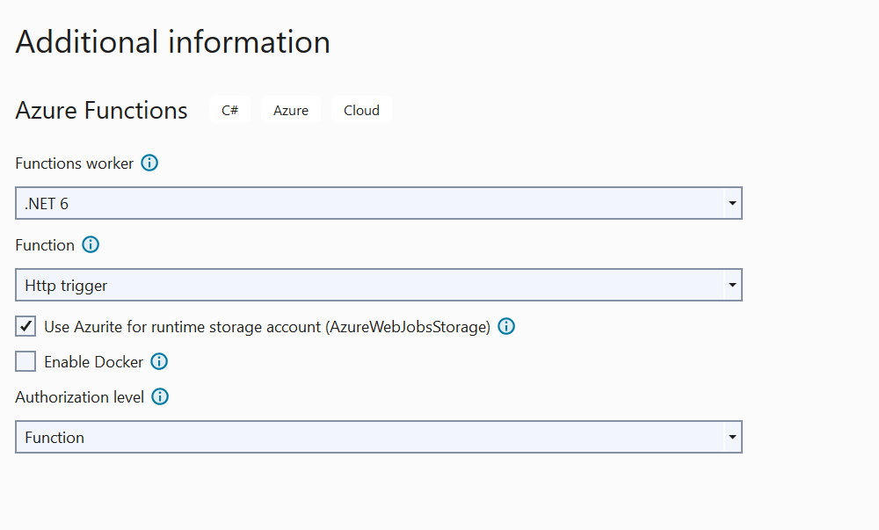
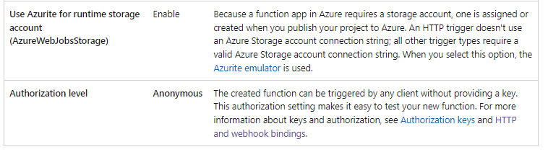

Path of my project :
C:\Users\ansagraw\Documents\Anshika\Repo\AzureFunctionDemo
Anonymous : I have selected

Slide 12
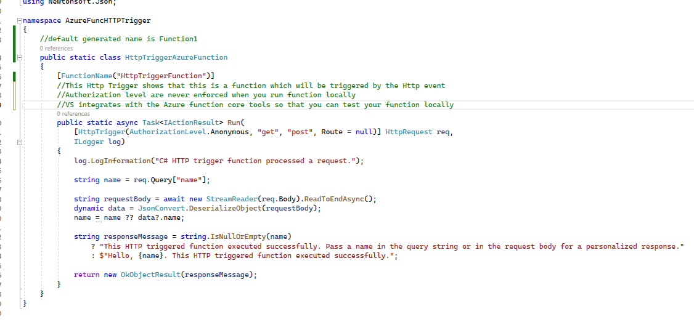
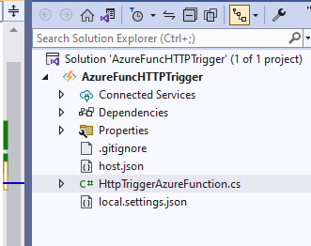
When we create the class library project, it by default creates above boiler plate project.
Visual Studio integrates with Azure Functions Core Tools so that you can test your functions locally using the full Azure Functions runtime.
Authorization levels are never enforced when you run a function locally.

Slide 13
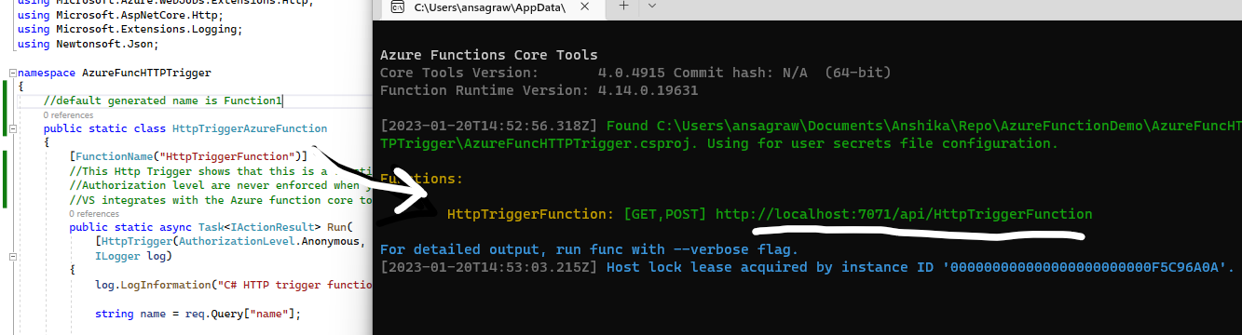
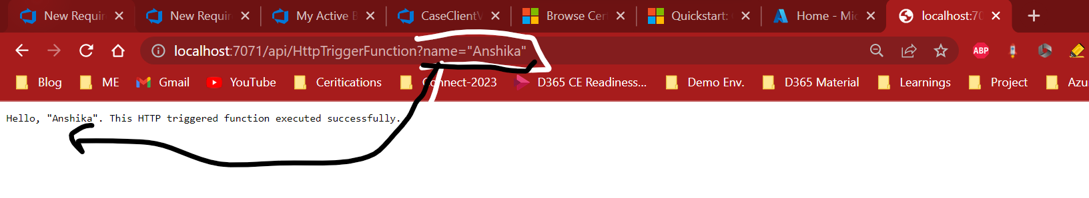

Above Azure function has been created and we have run the function using Ctrl + F5.
Now once we run it, it open a window and provide the URL which will be our Http trigger.
We can copy and hit that request from browser, which will call this function and send the response to the browser.

Slide 14
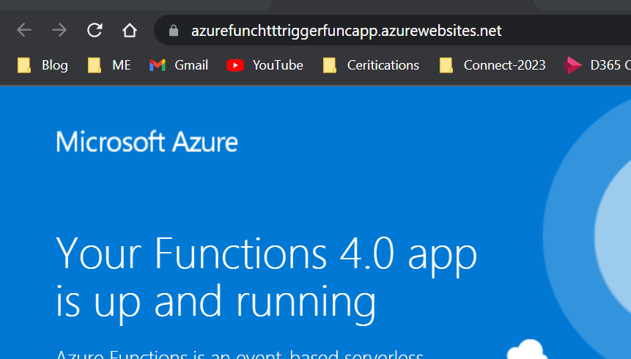
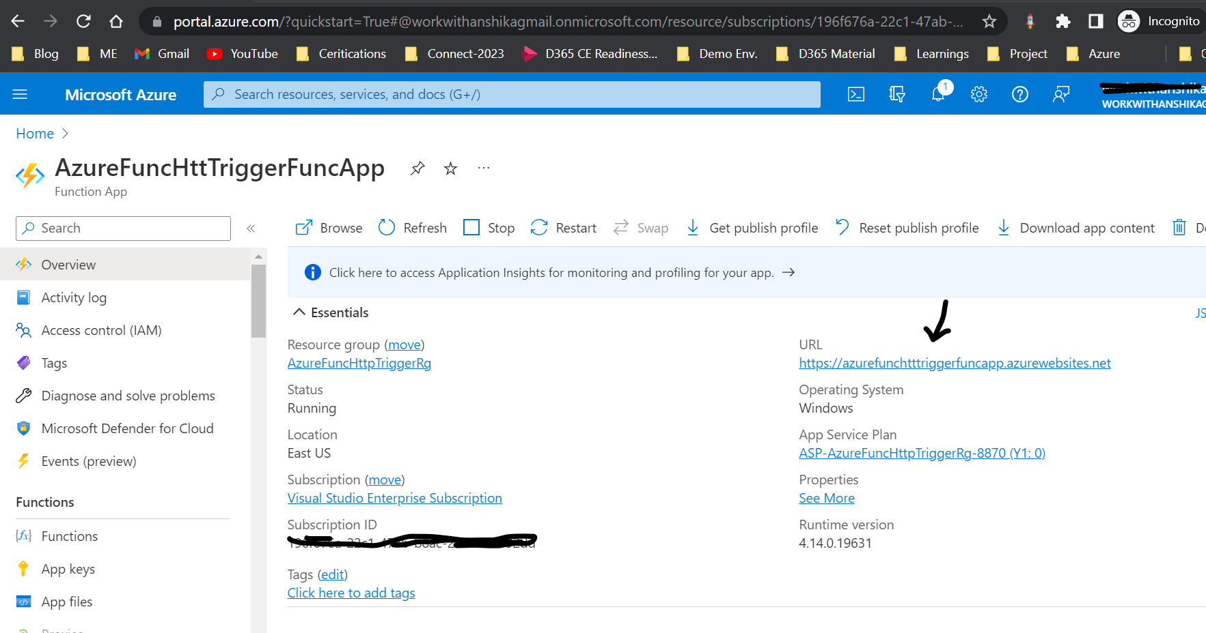
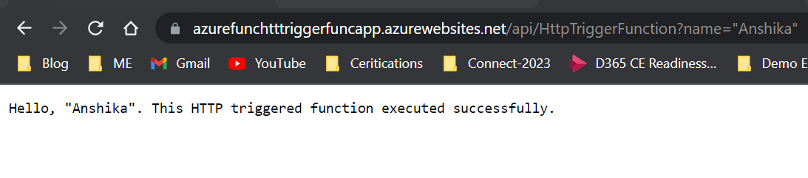
Publish Project to Azure
From the visual studio we can publish our azure function to the Azure.
Before we publish Azure Function to the Azure, we should have Function App in Azure.
So, we can create function app on the go while publishing or we can choose, existing function app for the deployment.
Now, once function app is created and we have published it to Azure Function App, open the link from the Azure portal and try running your azure function.
Note: To publish, we have created resource group, function App, storage account.

Slide 15
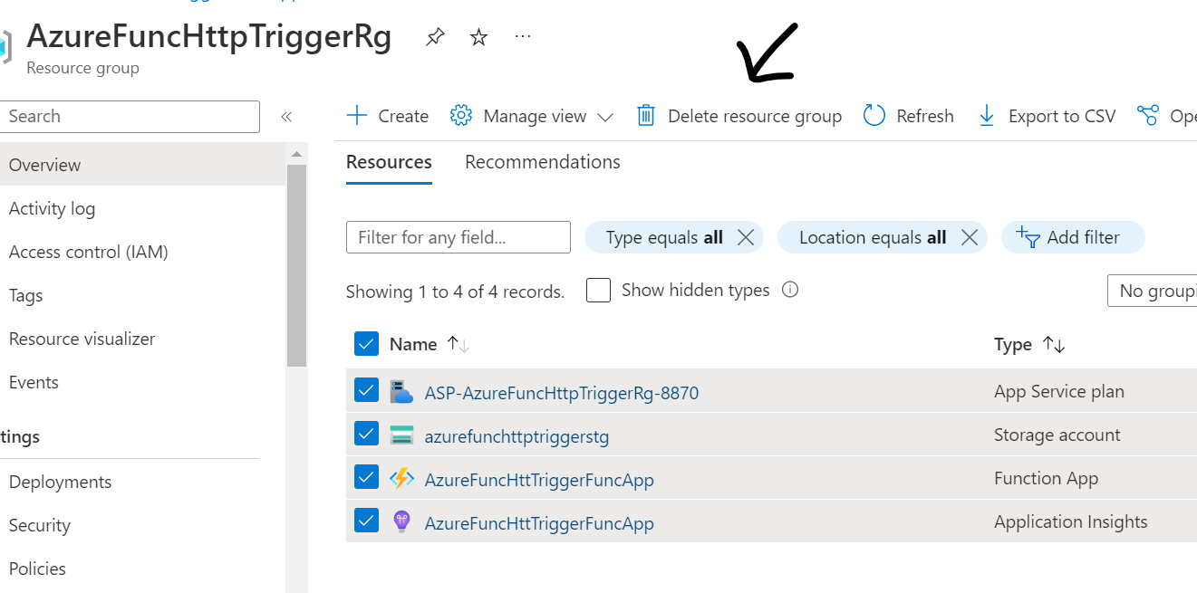
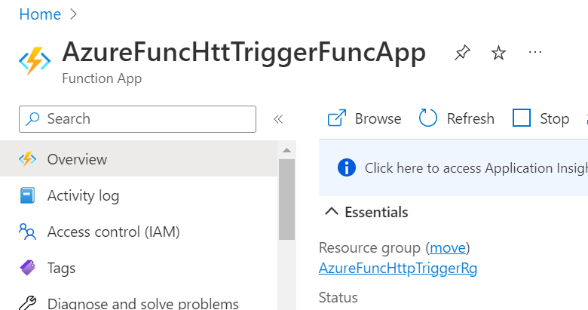
Clean Up Resource
Now, its time to clean up our resources if we are done testing.
Resources in Azure refer to function apps, functions, storage accounts, and so forth. They're grouped into resource groups, and you can delete everything in a group by deleting the group.
Open Portal -> Go to the Azure function App -> select resource group

